Slide 2
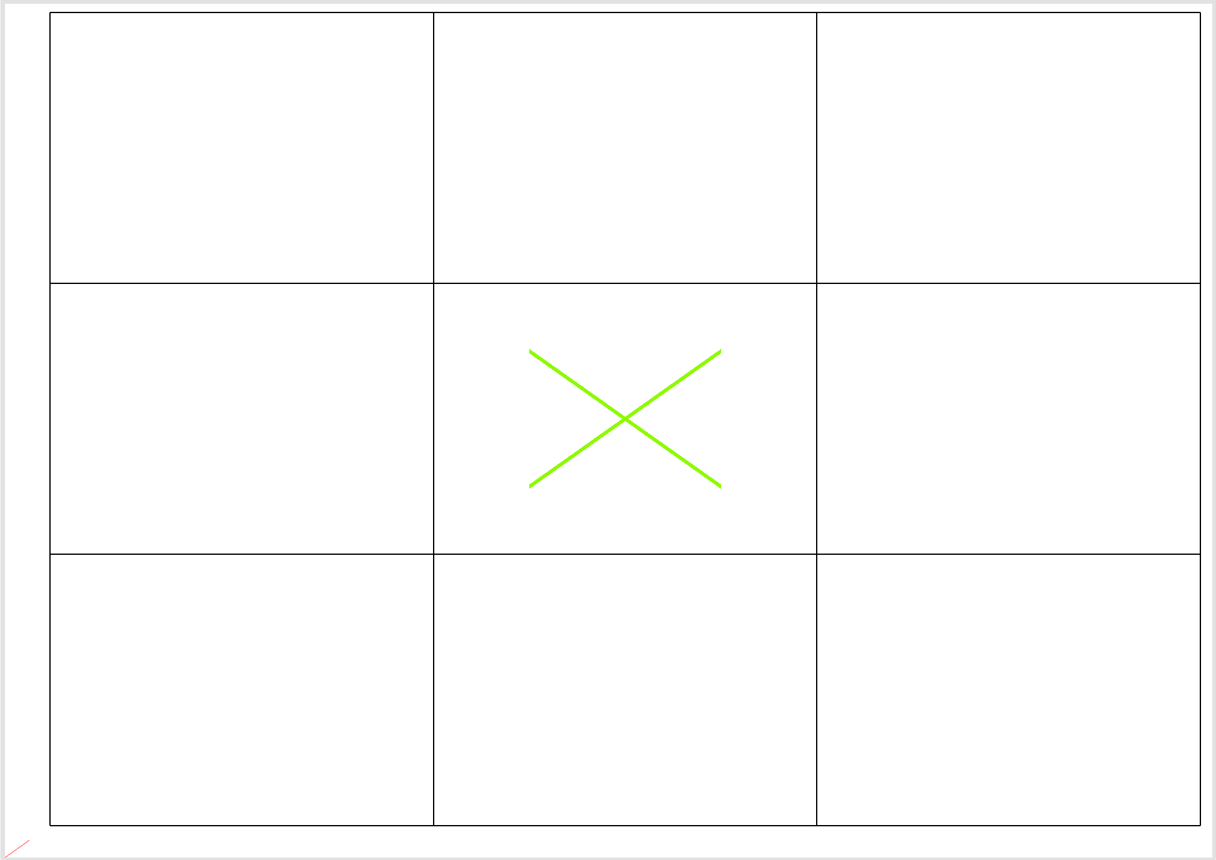

Slide 3
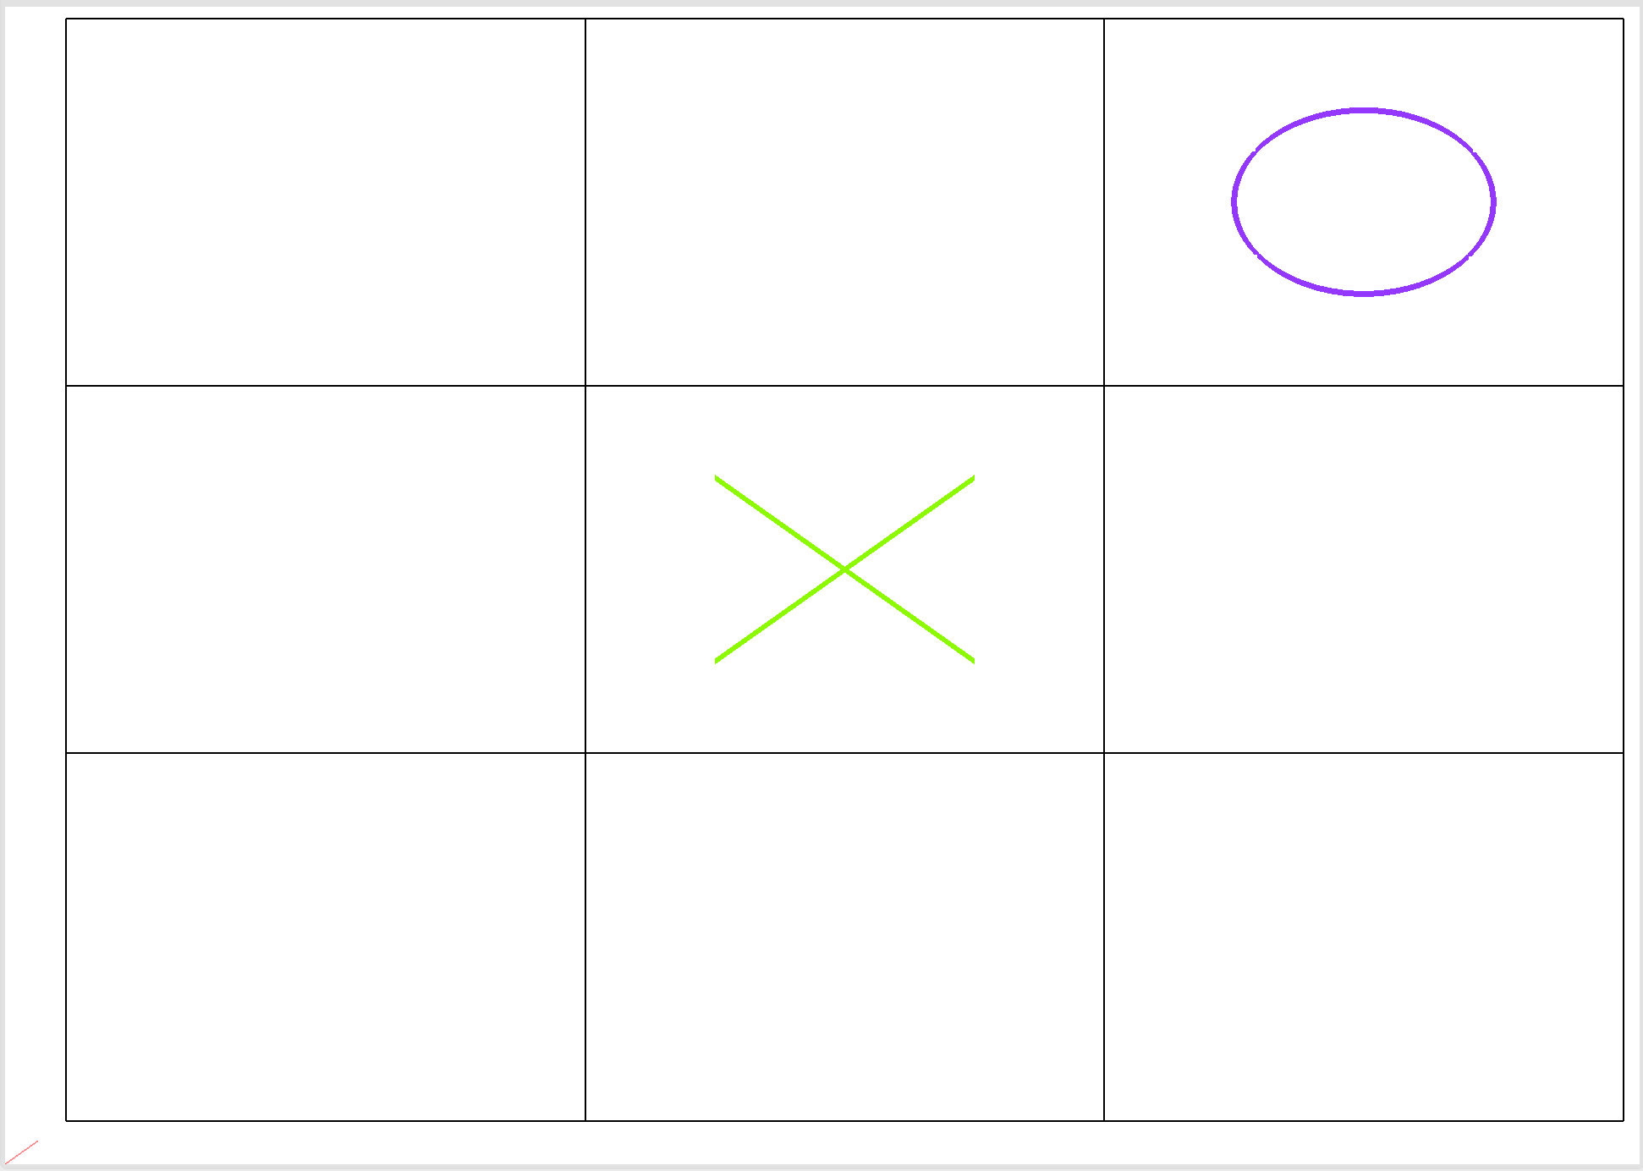

Slide 4
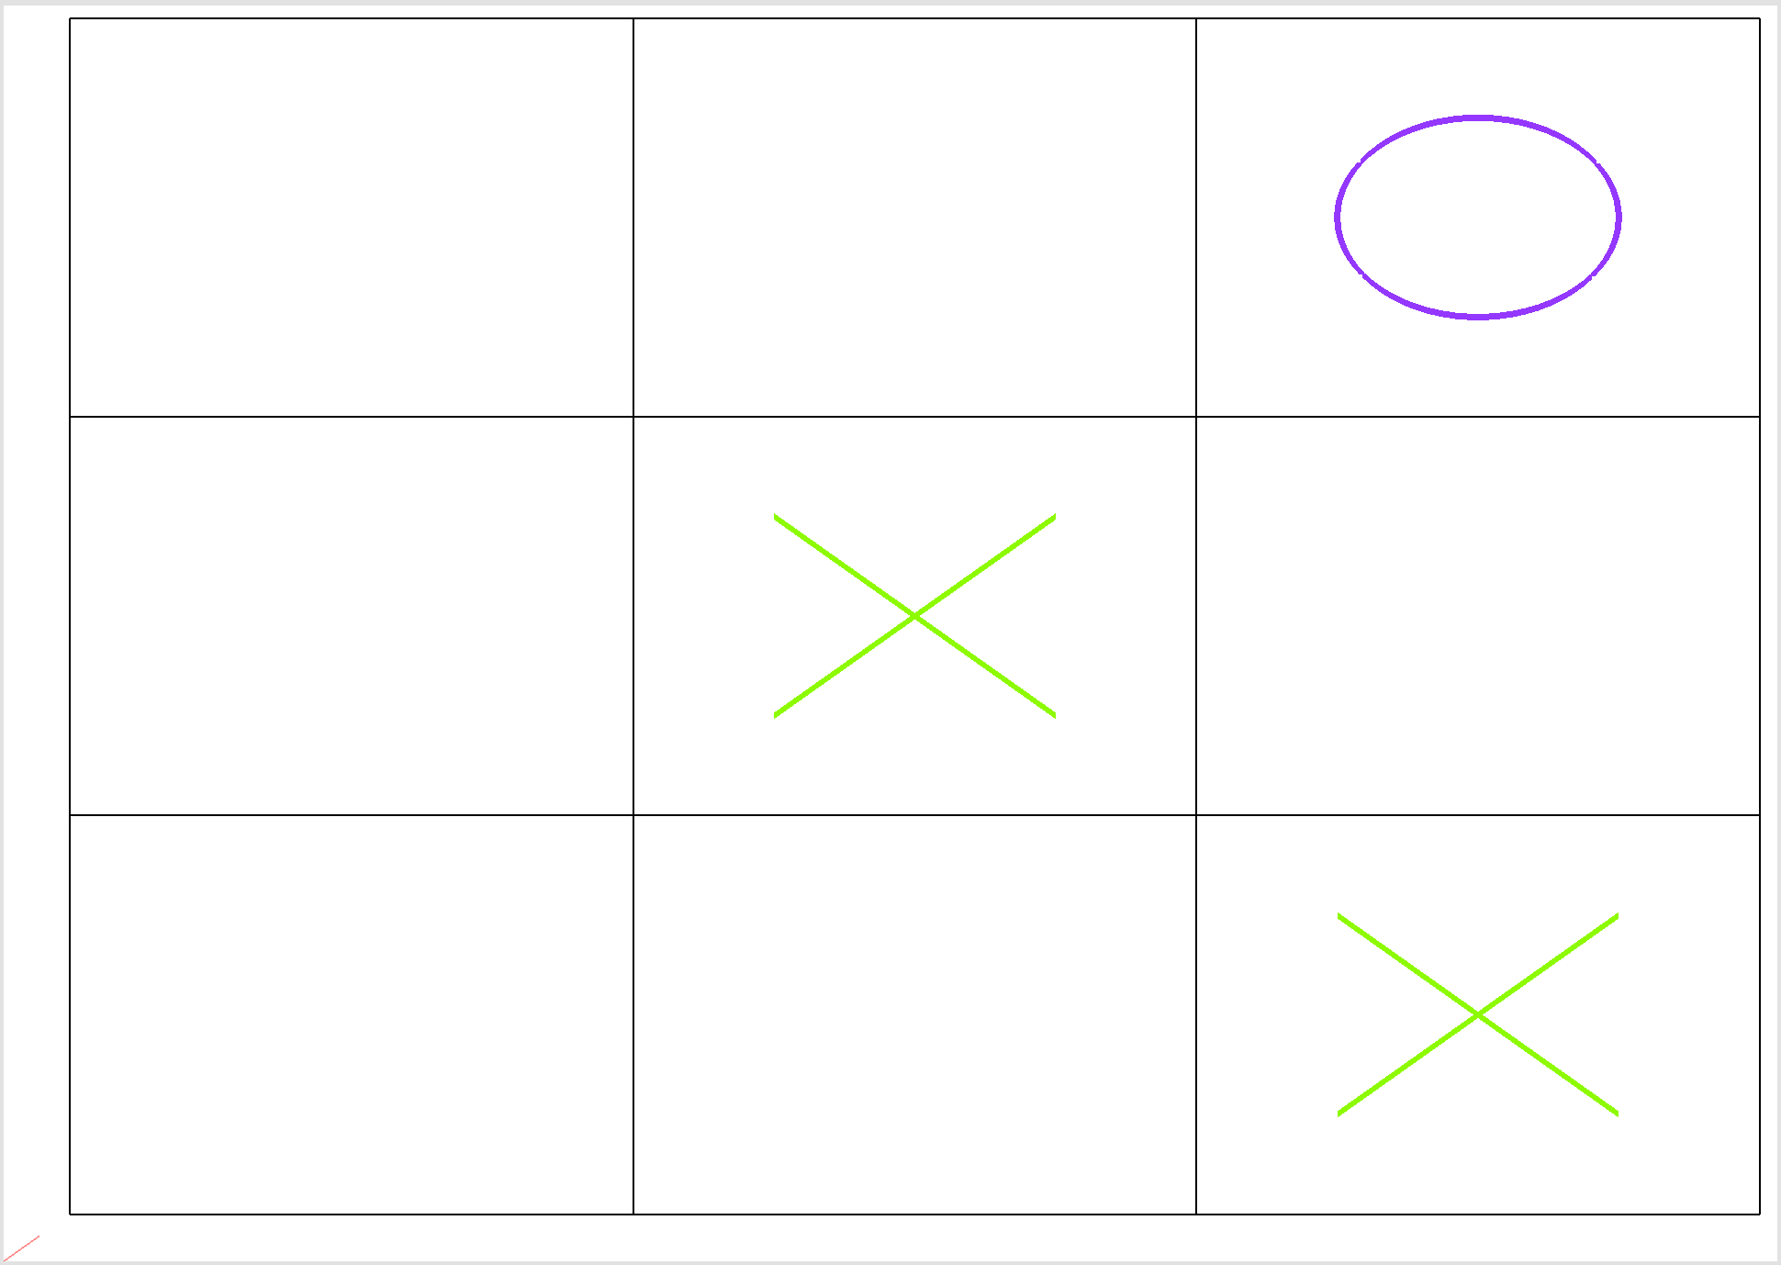

Slide 5
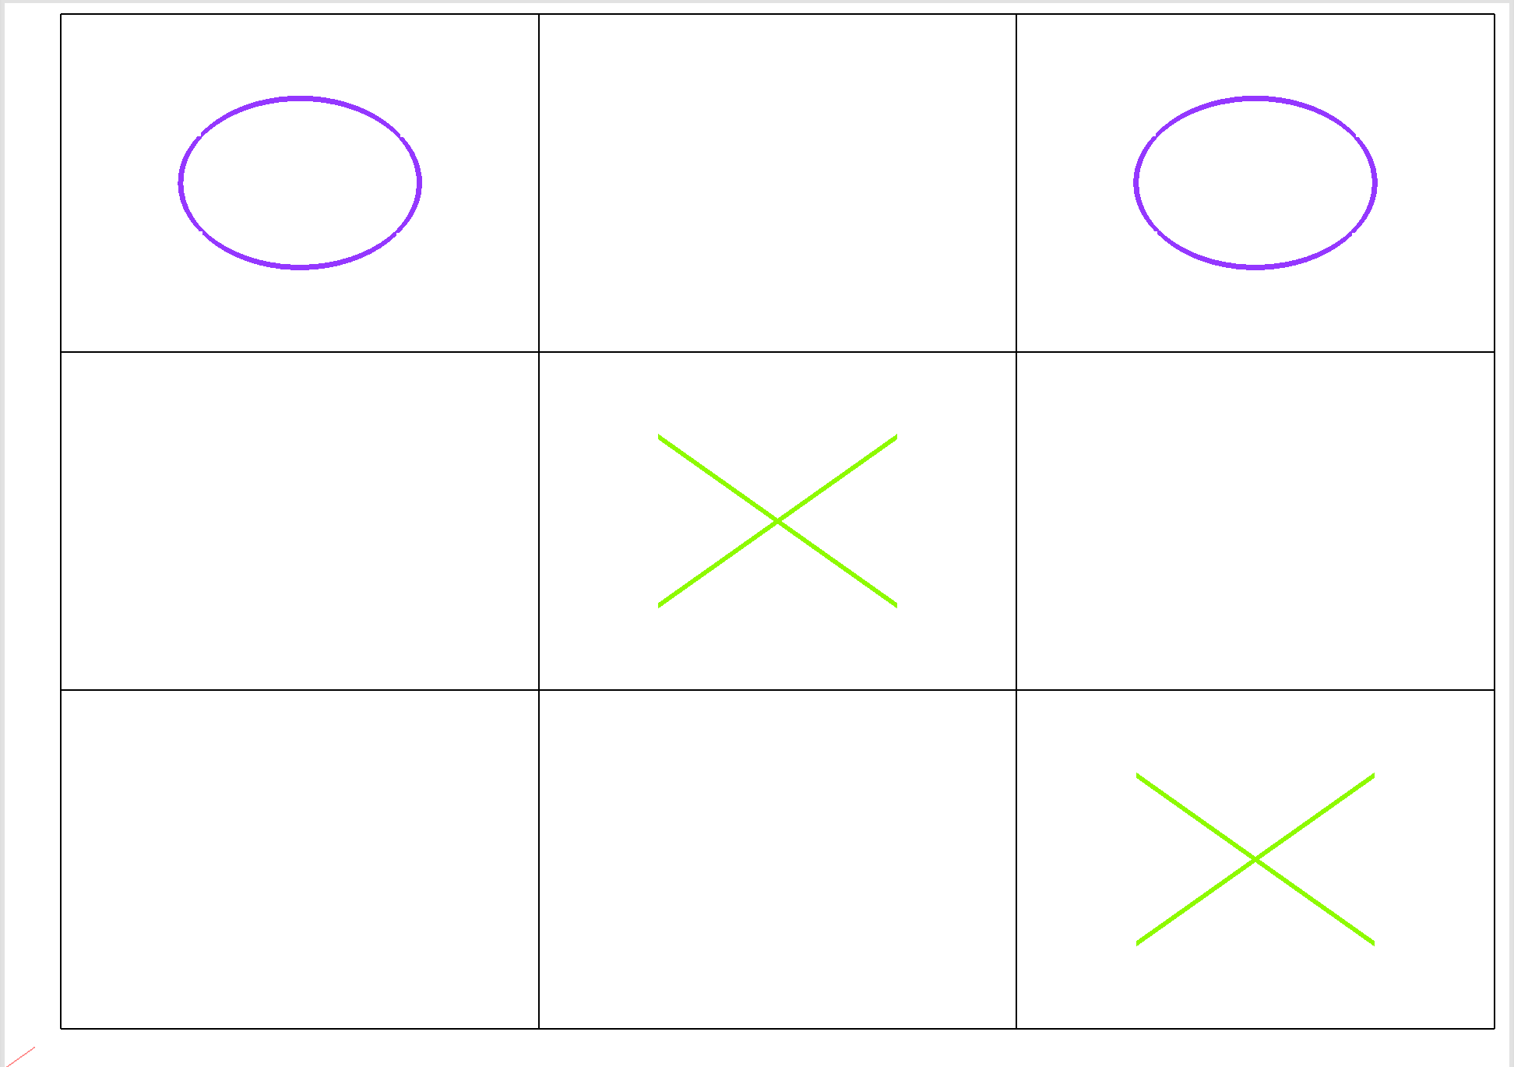

Slide 6
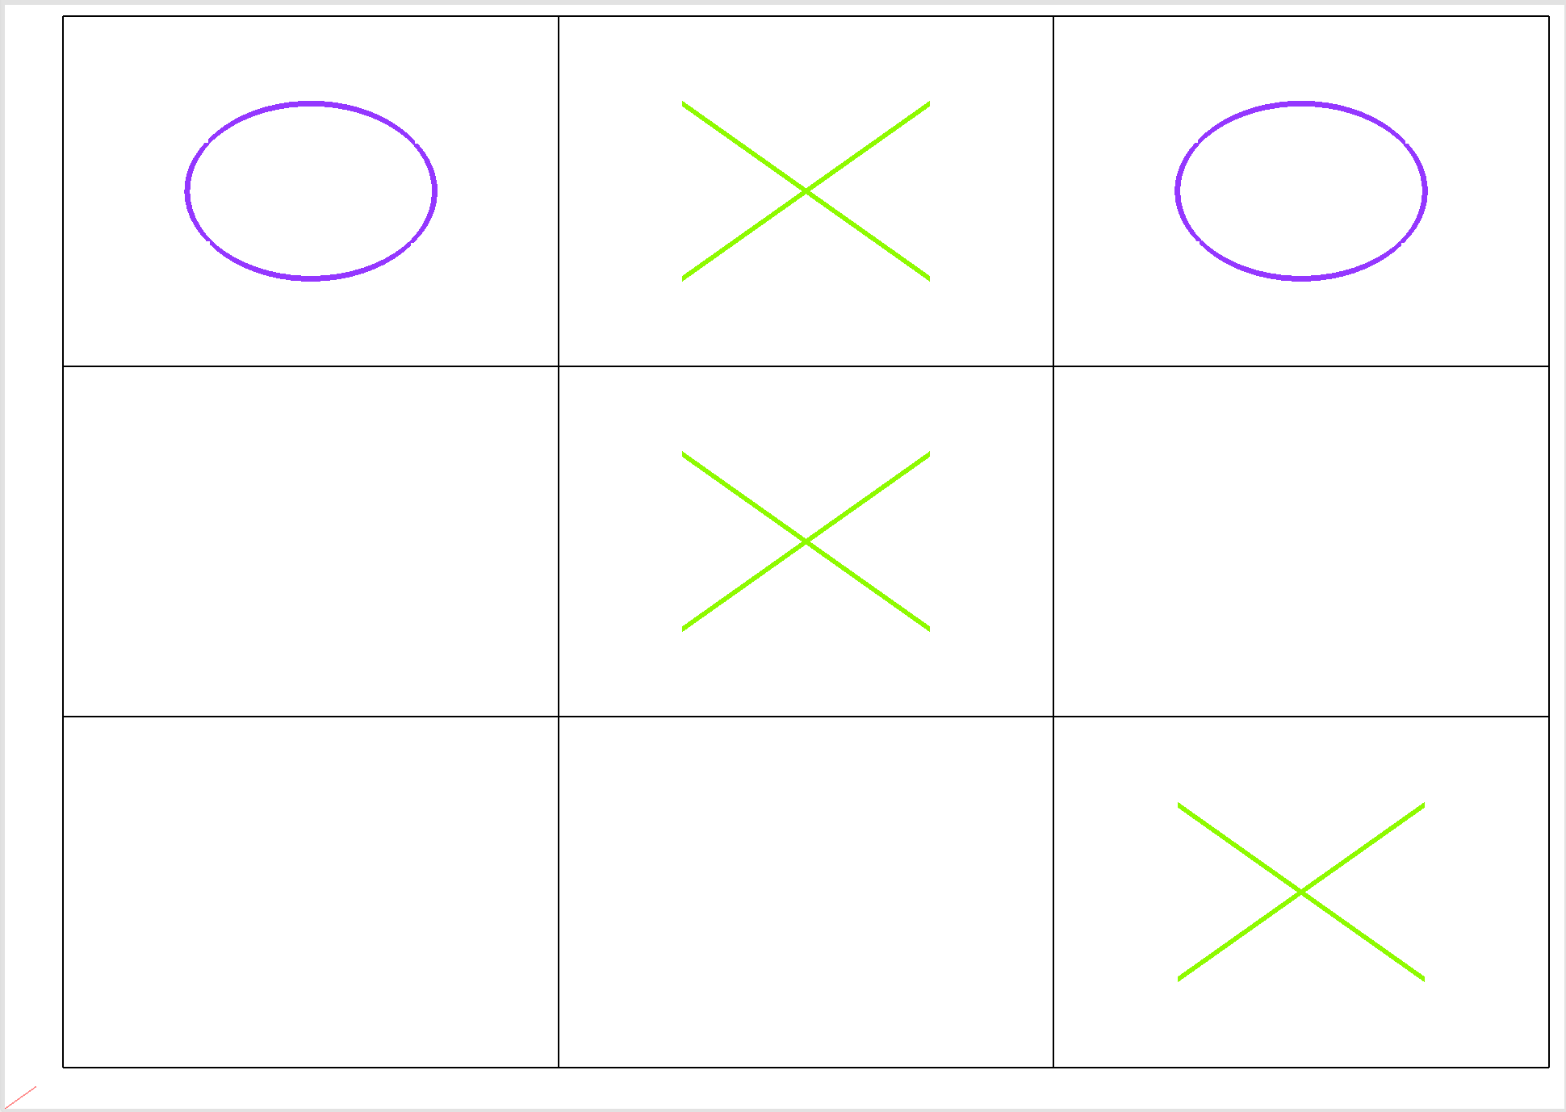

Slide 7
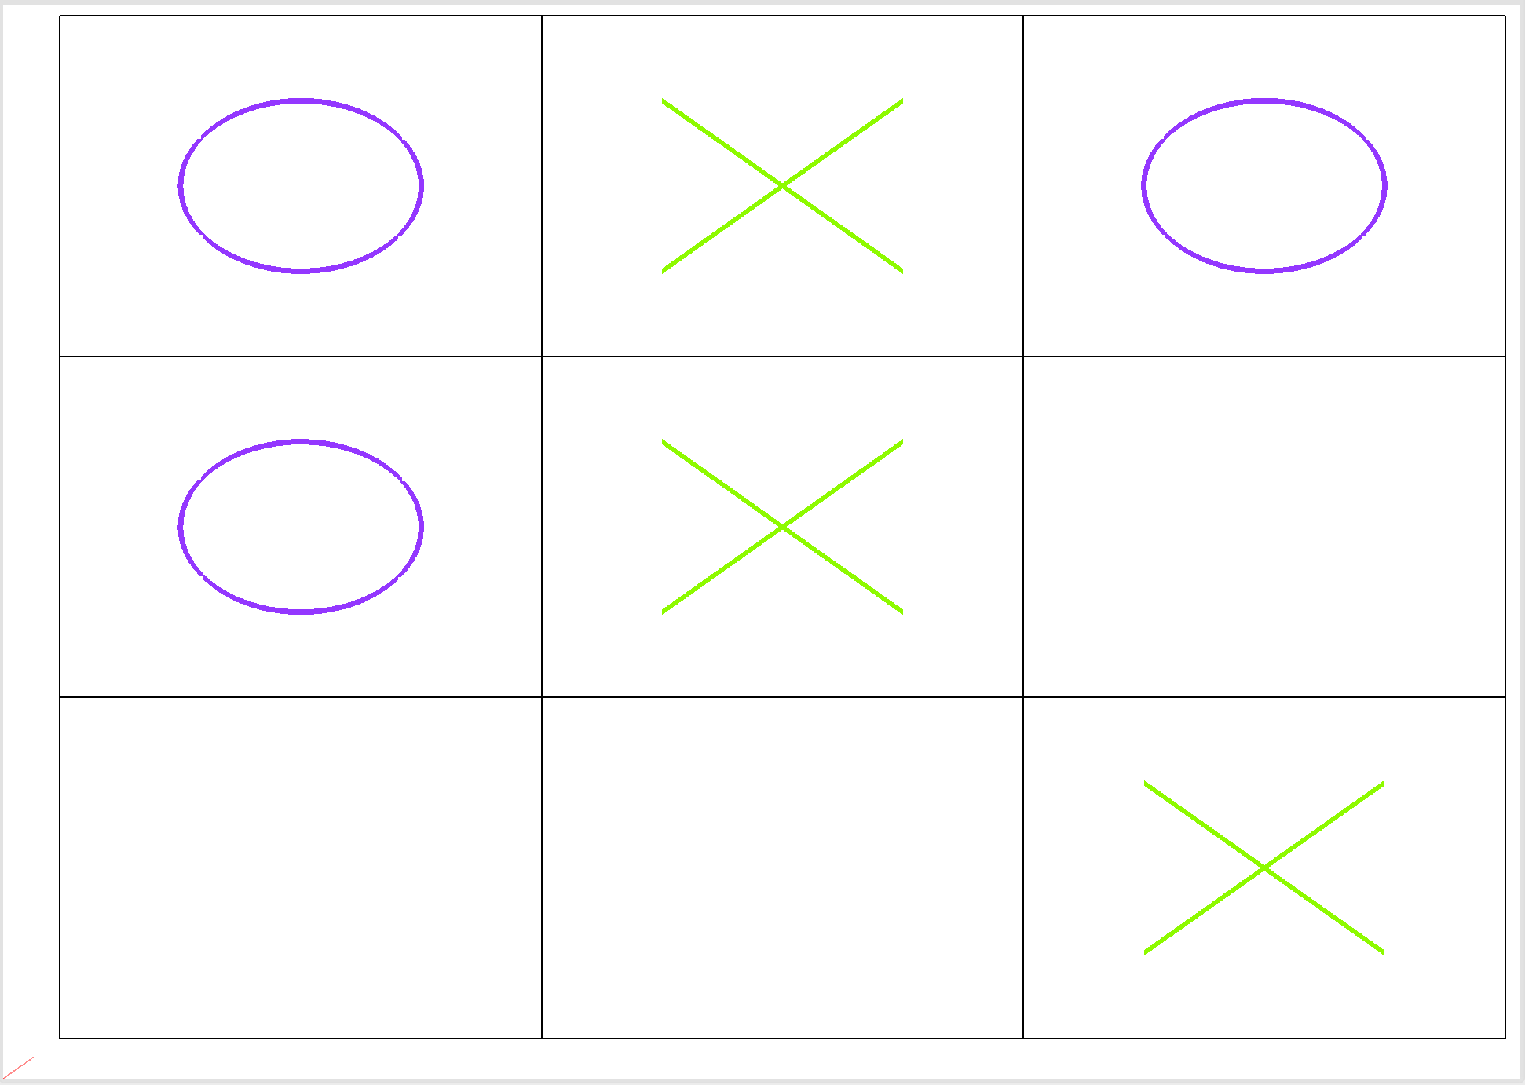

Slide 8
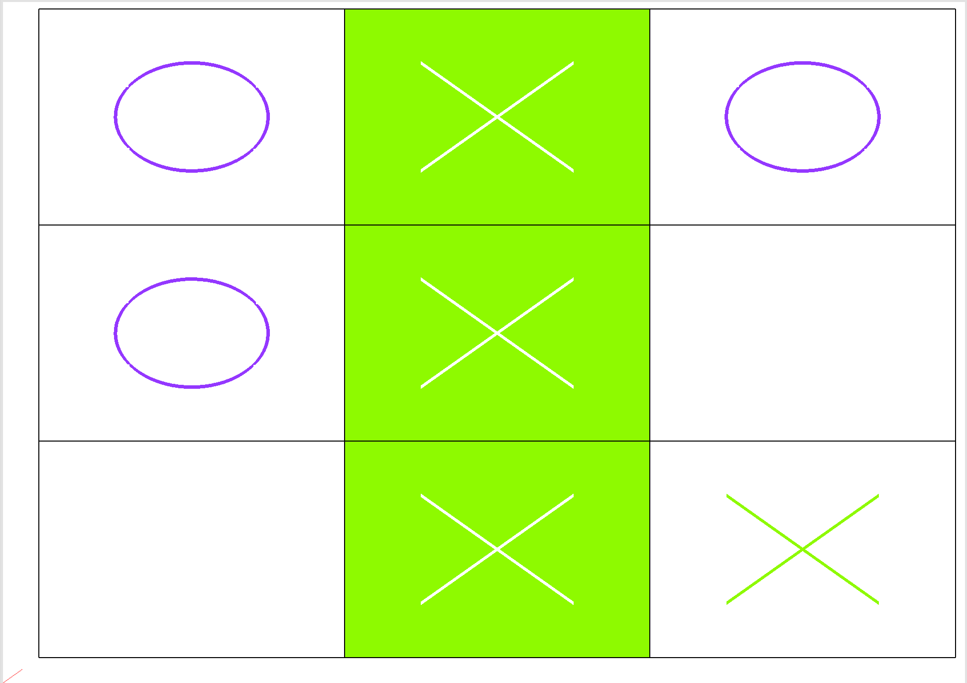

Slide 9
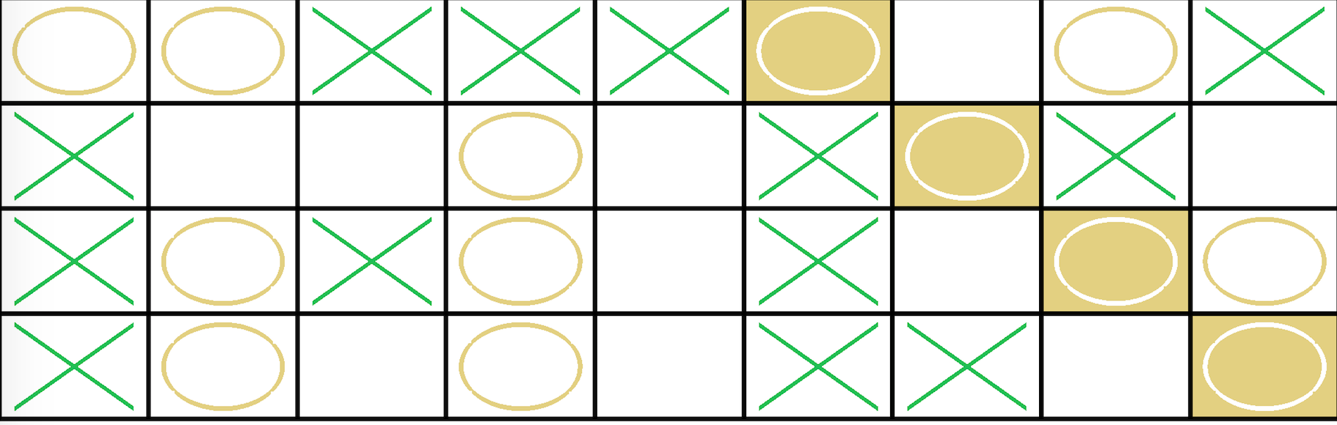
9-4-4

Slide 11
The “Right” Answer
[Wins, Losses, Draws]
1-Base [4470, 530, 0]
2-LowNoiseLayer2 [3811, 1189, 0]
3-LowNoiseLayer3 [2712, 2288, 0]
4-MedNoiseLayer5 [2017, 2982, 1]
5-MedNoiseLayer4 [1474, 3514, 12]
6-MedNoiseLayer1 [503, 4484, 13]
Round-robin Tournament results - 1000 games per matchup, alternating playing 1st
1-Base 2-LowNoiseLayer2 3-LowNoiseLayer3 4-MedNoiseLayer5 5-MedNoiseLayer4 6-MedNoiseLayer1
1-Base - - - - - [726, 274, 0] [837, 163, 0] [967, 33, 0] [965, 35, 0] [975, 25, 0]
2-LowNoiseLayer2 [274, 726, 0] - - - - - [668, 332, 0] [940, 60, 0] [965, 35, 0] [964, 36, 0]
3-LowNoiseLayer3 [163, 837, 0] [332, 668, 0] - - - - - [526, 474, 0] [913, 87, 0] [778, 222, 0]
4-MedNoiseLayer5 [33, 967, 0] [60, 940, 0] [474, 526, 0] - - - - - [592, 408, 0] [858, 141, 1]
5-MedNoiseLayer4 [35, 965, 0] [35, 965, 0] [87, 913, 0] [408, 592, 0] - - - - - [909, 79, 12]
6-MedNoiseLayer1 [25, 975, 0] [36, 964, 0] [222, 778, 0] [141, 858, 1] [79, 909, 12] - - - - -

Slide 13
1-Base vs HeurBaseK: [41, 959, 0]
1-Base vs HeurBase3: [41, 959, 0]
1-Base vs HeurBase2: [172, 828, 0]
1-Base vs Aggressive: [156, 844, 0]
1-Base vs Defensive: [11, 666, 323]
1-Base vs bRANDy: [982, 18, 0]
Total score for 1-Base [1403, 4274, 323](1-Base)
2-LowNoiseLayer2 vs HeurBaseK: [10, 990, 0]
2-LowNoiseLayer2 vs HeurBase3: [10, 990, 0]
2-LowNoiseLayer2 vs HeurBase2: [163, 837, 0]
2-LowNoiseLayer2 vs Aggressive: [1, 999, 0]
2-LowNoiseLayer2 vs Defensive: [0, 720, 280]
2-LowNoiseLayer2 vs bRANDy: [942, 57, 1]
Total score for 2-LowNoiseLayer2 [1126, 4593, 281](2-LowNoiseLayer2)
3-LowNoiseLayer3 vs HeurBaseK: [5, 995, 0]
3-LowNoiseLayer3 vs HeurBase3: [7, 993, 0]
3-LowNoiseLayer3 vs HeurBase2: [73, 927, 0]
3-LowNoiseLayer3 vs Aggressive: [40, 960, 0]
3-LowNoiseLayer3 vs Defensive: [8, 557, 435]
3-LowNoiseLayer3 vs bRANDy: [929, 67, 4]
Total score for 3-LowNoiseLayer3 [1062, 4499, 439](3-LowNoiseLayer3)
4-MedNoiseLayer5 vs HeurBaseK: [0, 1000, 0]
4-MedNoiseLayer5 vs HeurBase3: [2, 998, 0]
4-MedNoiseLayer5 vs HeurBase2: [10, 990, 0]
4-MedNoiseLayer5 vs Aggressive: [0, 1000, 0]
4-MedNoiseLayer5 vs Defensive: [0, 810, 190]
4-MedNoiseLayer5 vs bRANDy: [730, 263, 7]
Total score for 4-MedNoiseLayer5 [742, 5061, 197](4-MedNoiseLayer5)
5-MedNoiseLayer4 vs HeurBaseK: [0, 1000, 0]
5-MedNoiseLayer4 vs HeurBase3: [1, 999, 0]
5-MedNoiseLayer4 vs HeurBase2: [27, 973, 0]
5-MedNoiseLayer4 vs Aggressive: [0, 1000, 0]
5-MedNoiseLayer4 vs Defensive: [0, 855, 145]
5-MedNoiseLayer4 vs bRANDy: [814, 182, 4]
Total score for 5-MedNoiseLayer4 [842, 5009, 149](5-MedNoiseLayer4)
6-MedNoiseLayer1 vs HeurBaseK: [3, 997, 0]
6-MedNoiseLayer1 vs HeurBase3: [0, 1000, 0]
6-MedNoiseLayer1 vs HeurBase2: [2, 998, 0]
6-MedNoiseLayer1 vs Aggressive: [8, 992, 0]
6-MedNoiseLayer1 vs Defensive: [0, 845, 155]
6-MedNoiseLayer1 vs bRANDy: [480, 499, 21]
Total score for 6-MedNoiseLayer1 [493, 5331, 176](6-MedNoiseLayer1)

